Slide 1




PsorAI:
Psoriasis Prediction, Detection, and Tailored Treatment with Genetic Insights
Brought to you by:
Farah Walid 222307
Rawan Walid 223177

Slide 2

Under the Supervision of:
TA:
Dr. Hanan Tarek
Co-Supervisor:
Dr. Marwa Solyaman
Supervisor:
Dr. Mohamed Nagy
03
02
01

Slide 3


OUR COLLABORATION!
This project is in partnership with the Faculty of Pharmacy at MSA University

Slide 5
Table of Contents
1
2
3
4
Introduction
Background/
Motivation
Problem Statement
Mission/Vision/Obj
5
6
7
8
Features List/System Overview
Related Work
Dataset
References

Slide 6
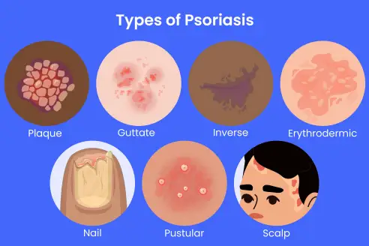
Introduction
Psoriasis is a chronic skin disease; rapid cell growth causes red, scaly patches
Visible appearance, rapid severity increase
Diagnosis: skin exam; biopsy if needed to rule out eczema
Healthline

Slide 7
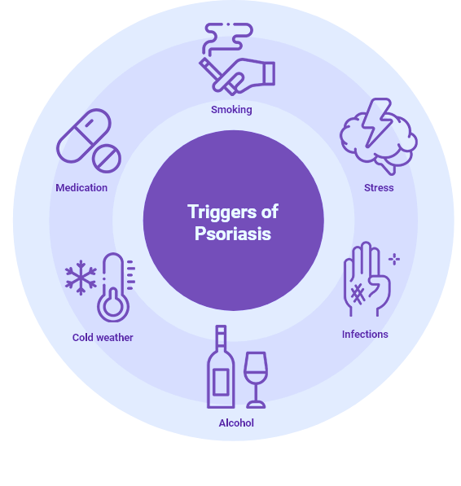
Background
Higher prevalence in men; earlier onset in women
1.5 times risk of depression/anxiety due to stigma, visible symptoms
30% develop psoriatic arthritis, leading to disability and emotional impact
Global prevalence: 0% to 11.8%, varies by location
Nyulangone

Slide 8
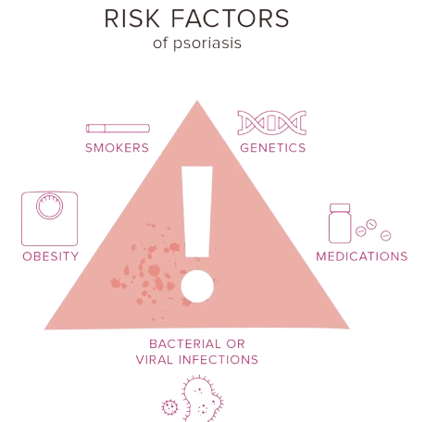
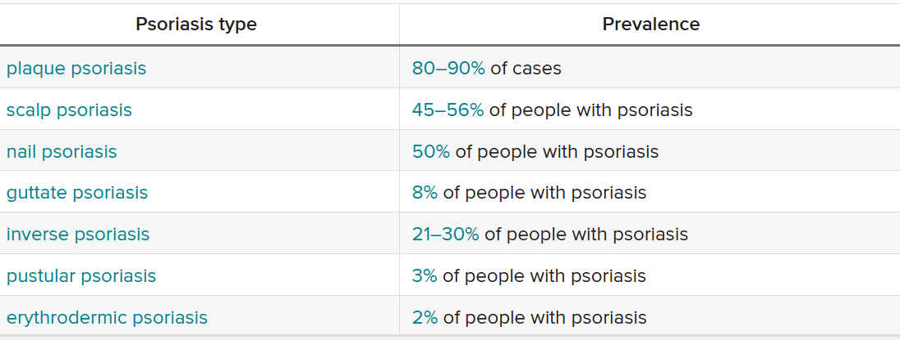
Background
Healthline

Slide 9


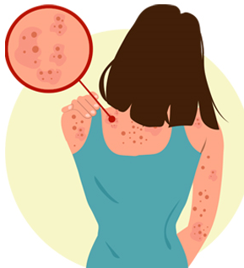
Motivation
Early detection and treatment
Slow progression, improve outcomes
Leverage Egyptian resources (dermatologists, Medical tourism)
Raise awareness & address the Middle Eastern medical gap

Slide 10
Prob
Stat
Problem Statement
Lack of Progression Control: Limited options exist to effectively slow the progression of psoriasis worldwide, precisely in Egypt.
Limited Data Availability: The size of the existing datasets is insufficient to enable accurate diagnosis and classification of psoriasis.

Slide 11

Mission & Vision
Mission
Vision
To improve psoriasis care by integrating advanced AI for early detection, genetic history, and personalized treatment, alongside resources for patient support and education in Egypt.
To be a leading platform for accessible, accurate, and supportive psoriasis management, empowering patients with better diagnosis, treatment, and understanding of their condition.

Slide 12

Early Prediction
Apply genetic analysis to assess & predict psoriasis risk for early intervention
Accurate Detection
Awareness & Support
Using ML & DL models to identify/classify & distinguish psoriasis from other similar disease
Objectives
Raise awareness of psoriasis with an engaging platform that provides several options
Setting stones of our journey
Personalized Treatment
Tailored treatment plans based on patient information

Slide 13


Related Work
Classification/
Detection
Genetic History
Overall Treatment
Notes:
For each domain we're working on, we have selected the best paper to serve as a reference for our work

Slide 14
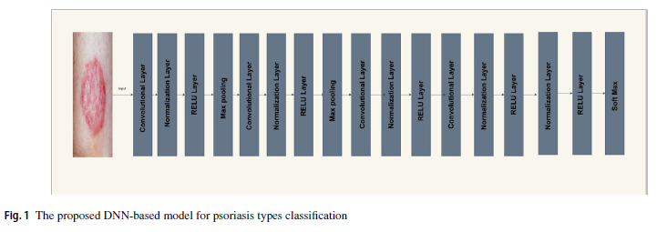
Automated Detection and Classification of Psoriasis
Types Using Deep Neural Networks
from Dermatology Images
Muhammad Sajid Rashid, Ghulam Gilanie, Saira Naveed, Sana Cheema, Muhammad Sajid. <2024>
Overall Summary: A lightweight DNN model classifies five psoriasis types from images, using RGB-to-YCbCr color transformation for enhanced feature extraction.
Models Used: 17-layer Deep Neural Network (DNN).
Conclusion: This model is effective for mobile deployment in remote areas, aiding in accessible dermatological diagnosis.
Challenges/Limitations: requires noise-free images.
Future Work: Expand to other skin conditions and improve robustness across image variations
https://link.springer.com/article/10.1007/s11760-023-02722-9

Slide 15
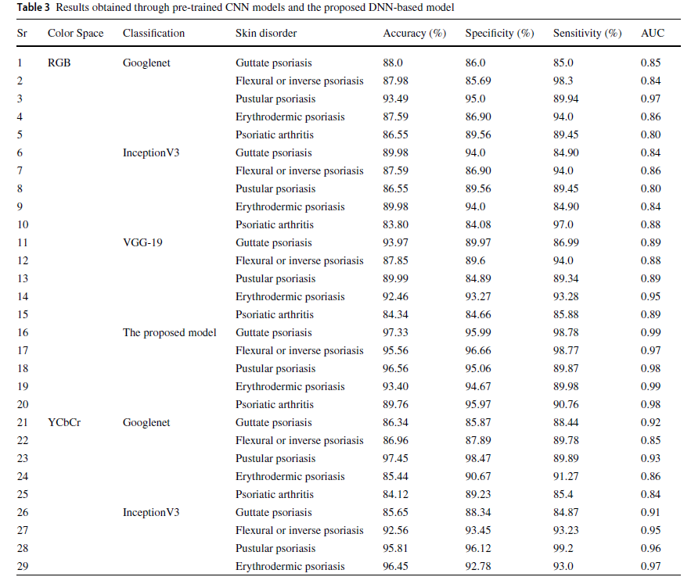
Continuation:

Slide 16
Identification of Gene Expression Signatures for Psoriasis Classification Using Machine Learning
Nguyen Quoc Khanh Le a,b,⇑, Duyen Thi Do c, Trinh-Trung-Duong Nguyen d, Ngan Thi Kim Nguyen e,
Truong Nguyen Khanh Hung f,g, Nguyen Thi Thu Trang h <2021>
Overall Summary: A machine learning-based model identifies gene expression biomarkers to classify psoriasis, providing insights into early diagnosis.
Models Used: Random Forest, SVM, kNN, and Naive Bayes.
Conclusion: Gene biomarkers can effectively differentiate psoriasis, aiding in early diagnosis.
Future Work: Larger datasets and consistent biomarker validation across studies.
https://www.sciencedirect.com/science/article/pii/S2590124920300018

Slide 17
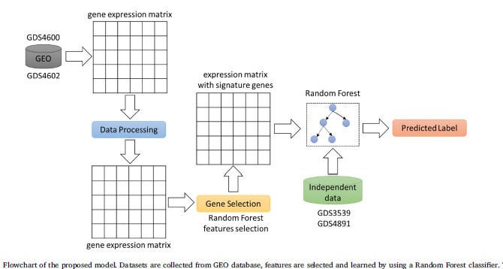
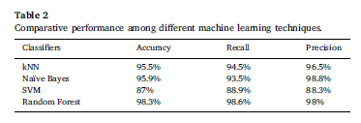
Continuation:

Slide 18
Diagnostic clinical decision support based on deep learning and
knowledge-based systems for psoriasis: From diagnosis to treatment options
Mohammad Yaseliani a, Abtin Ijadi Maghsoodi b,c,*, Erfan Hassannayebi d, Uwe Aickelin <2024>
Overall Summary: An ensemble CNN model performs both diagnosis and treatment recommendations for psoriasis, integrating Multi-Criteria Decision Making (MCDM) for treatment.
Models Used: Ensemble CNN (ResNet50V2, ResNet101V2, ResNet152V2).
Conclusion: The model effectively supports psoriasis diagnosis and treatment recommendation.
Challenges/Limitations: Lower accuracy for rarer types due to limited data.
Future Work: Enhance data diversity for better classification of rarer psoriasis types.
https://www.sciencedirect.com/science/article/pii/S0360835223007787

Slide 19
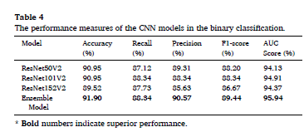
Continuation:

Slide 20
Datasets
Detection domain of our project, we've gathered a total of 23 datasets
13 Datasets related to psoriasis (total 31k)
14 Datasets related to eczema (total 29k)
3 Datasets related to atopic dermatitis (total 2.5k)
1 Dataset related to Seborrheic Dermatitis (total 1.5 k)
4 Datasets related to the normal skin (total 5.5k)
Prediction domain of our project, 2 datasets
GDS4602[ACCN]- Psoriasis lesional and non-lesional skin (170 records)
Psoriasis Genes(8k + records)
Nyulangone

Slide 21
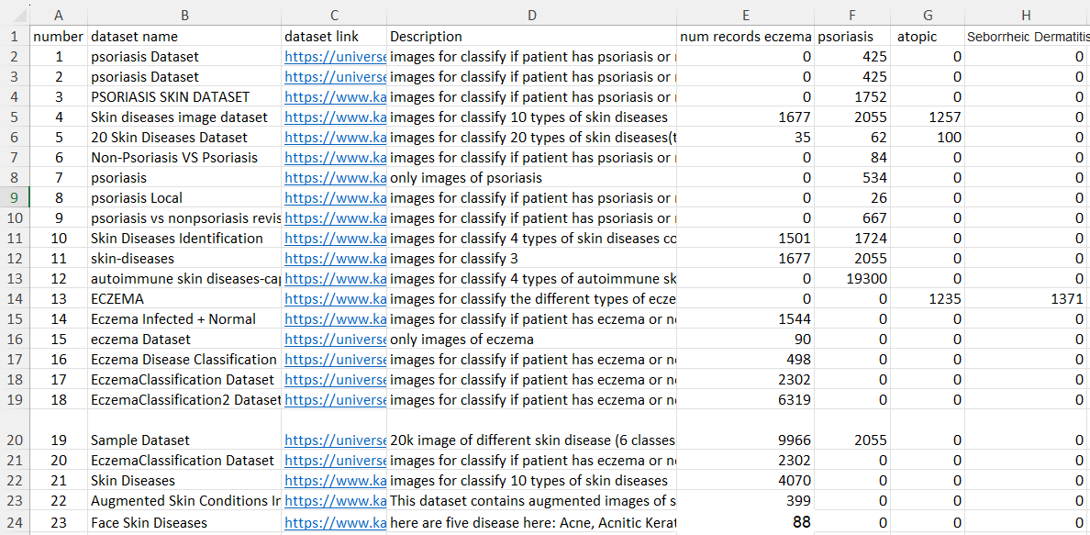
Datasets

Slide 22
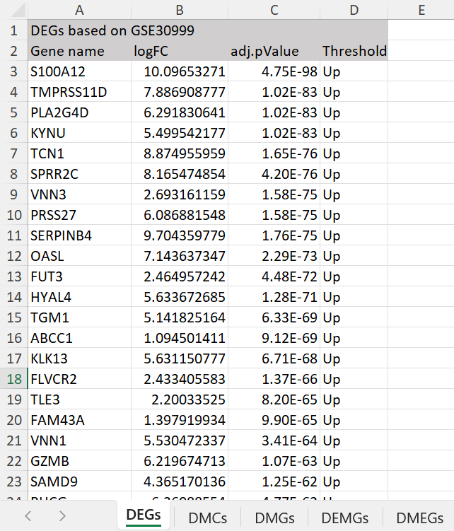
Datasets
Glimpse of the Genetic History Dataset

Slide 23
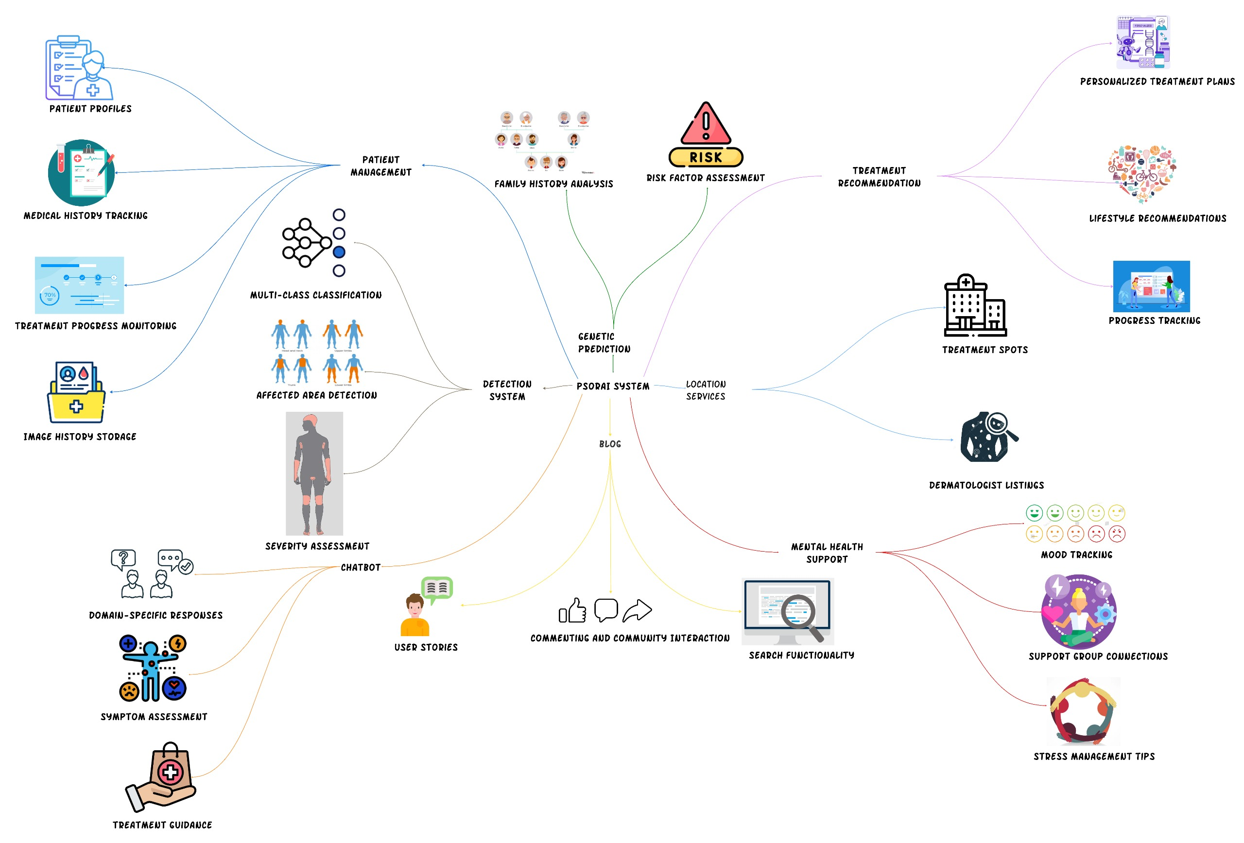
Feature
List

Slide 24
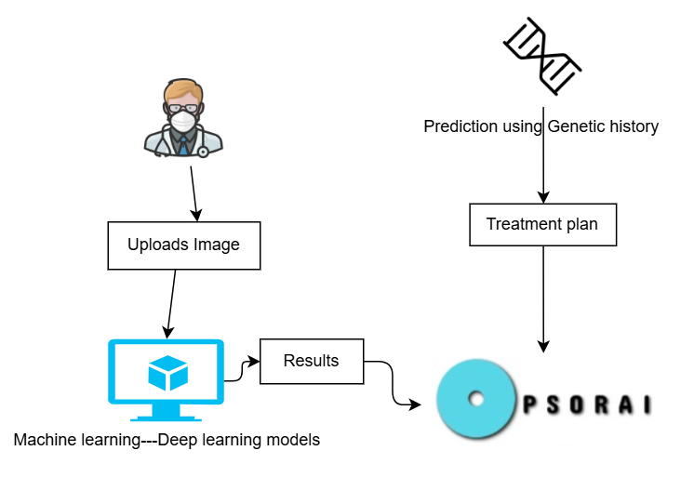
System Overview

Slide 25
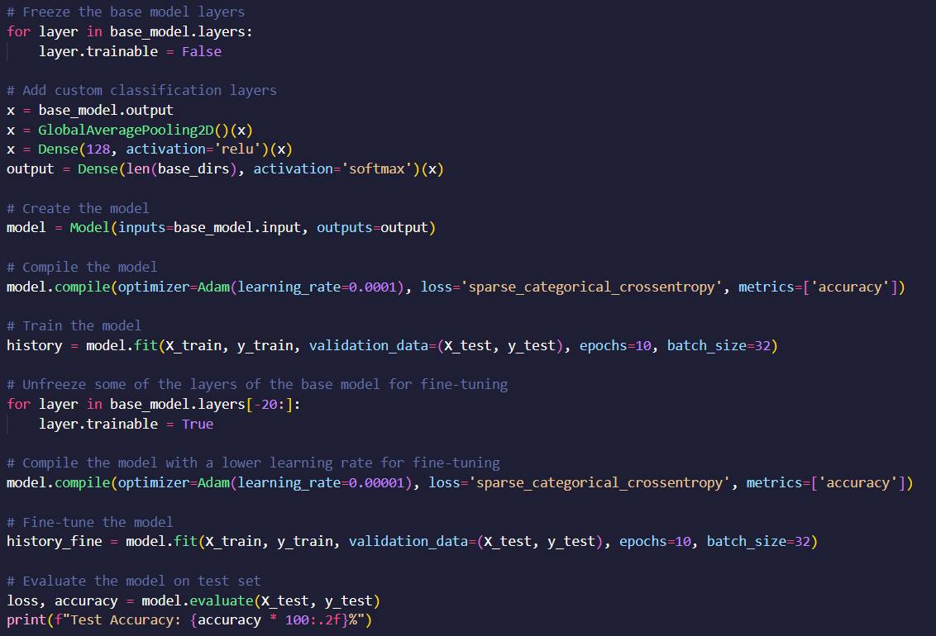
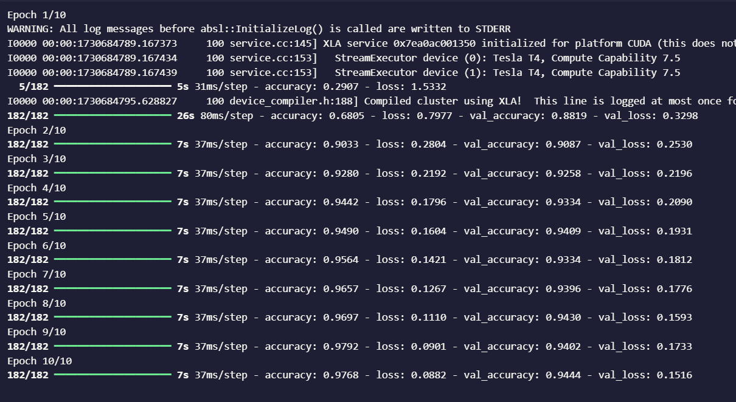

Short Demo

Slide 26
References
Healthline. (n.d.). Psoriasis: Causes and Risk Factors. Retrieved from https://www.healthline.com/health/psoriasis/facts-statistics-infographic#causes-and-risk-factors
NYU Langone Health. (n.d.). Psoriasis: Diagnosis. Retrieved from https://nyulangone.org/conditions/psoriasis/diagnosis#:~:text=Skin%20Biopsy,skin%20biopsy%20may%20be%20performed
Rashid, M. S., Gilanie, G., Naveed, S., Cheema, S., & Sajid, M. (2024). Automated detection and classification of psoriasis types using deep neural networks from dermatology images. Signal, Image and Video Processing. https://link.springer.com/article/10.1007/s11760-023-02722-9
Le, N. Q. K., Do, D. T., Nguyen, T.-T.-D., Nguyen, N. T. K., Hung, T. N. K., & Trang, N. T. T. (2021). Identification of gene expression signatures for psoriasis classification using machine learning techniques. iScience, 23(4), 1000018. https://www.sciencedirect.com/science/article/pii/S2590124920300018
Yaseliani, M., Ijadi Maghsoodi, A., Hassannayebi, E., & Aickelin, U. (2024). Diagnostic clinical decision support based on deep learning and knowledge-based systems for psoriasis: From diagnosis to treatment options. Computers in Biology and Medicine, 163, 106778. https://www.sciencedirect.com/science/article/pii/S0360835223007787

Slide 27
THANK YOU!

